Slide 1
Welcome

Slide 2
Jo James
Chief Executive, Kent Invicta Chamber of Commerce

Slide 3
Don Bowman
Head of Procurement, University of Kent

Slide 4


Procurement at the University of Kent
Presented by Don Bowman MCIPS

Slide 5


Presenter : Don Bowman MCIPS
d.bowman@kent.ac.uk
Member of Chartered Institute of Purchasing and Supply (MCIPS)
Head of Procurement - The University of Kent
Over 20 years in Procurement management – Broadcasting/MAFF/SFA/HoL
Public and private sector experience

Slide 6
Contents
University of Kent procurement
Local procurement agenda
Finding public sector opportunities
Bidding for public sector work
Improving your chances of winning

Slide 7

University of Kent procurement
About us
How we buy
What we buy

Slide 8
The University of Kent
UK top 20 University
20,000 students
6,000 staff
£200m annual turnover
Capital programme of £200m in next 5 years
2 UK campuses at Canterbury and Medway
plus Brussels, Paris, Rome and Athens

Slide 9
How we buy
Devolved budget structure
Central team of 4 who run competitions/procure for small Schools/Departments
Schools and Department have ultimate say in what, not how
Central procurement system – we set up new suppliers
All major procurements (over £20k) centrally
Control of e-tendering system

Slide 10
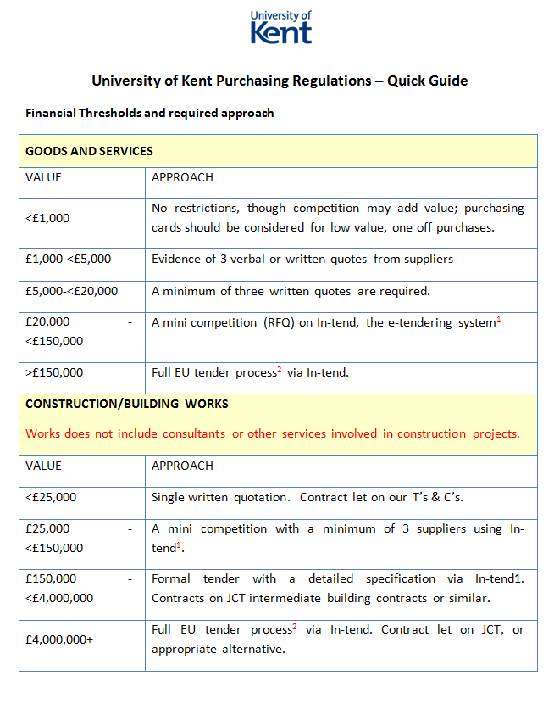
Procurement Procedures

Slide 11
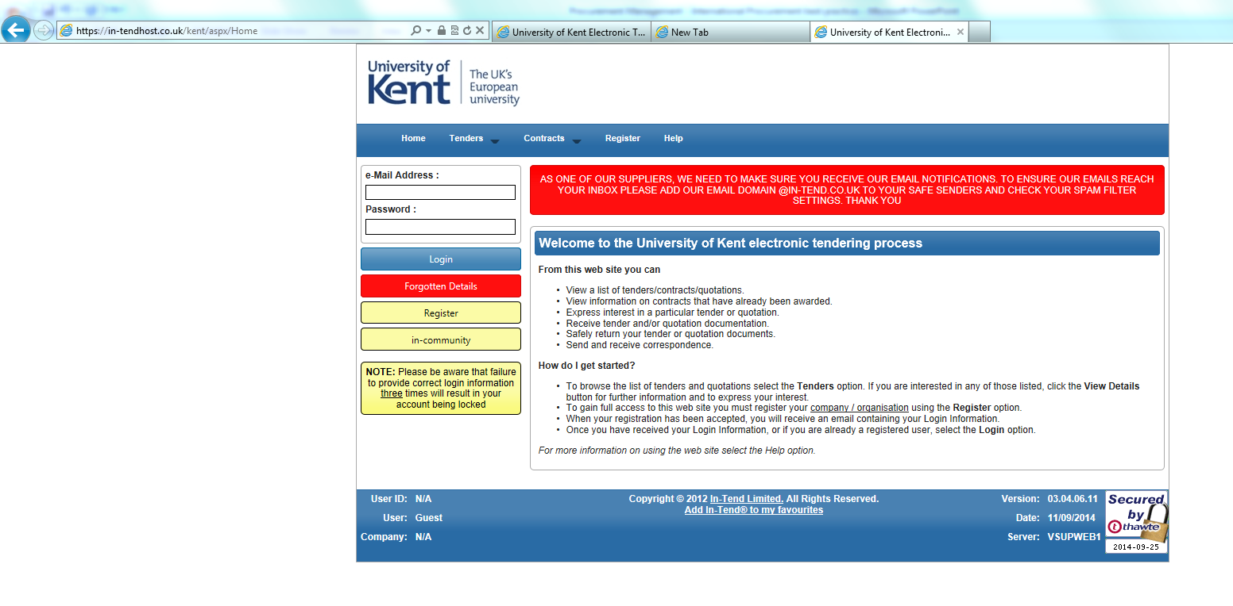
Below EU threshold advertising
www.in-tendhost.co.uk/kent/aspx/Home

Slide 12

The advantages of e-tendering
Allows electronic submission of tender documents and tender replies
We upload any reference materials/drawings that suppliers may need
Suppliers submit their responses online
A controlled and audited system
Suppliers can be allowed to submit one or multiple documents
Allows questions to be asked and answers shared
Systems also used for Contract Management

Slide 13


Purchasing Consortia
Grouping of buyers - extensive in public sector
Occasionally exist in other markets, hotels/restaurants
Examples:
Southern Universities Purchasing Consortium
Crown Commercial Services

Slide 14

Frameworks
Use of buying consortia frameworks for:
  IT hardware
  Laboratory equipment
  Furniture
  Travel
  Stationery
  Food and beverage

Slide 15

What we buy
Major spend categories
  Construction
  IT
  Facilities
  Consultancy services
  Food and beverage
  Anything required for delivery of education, hospitality and estate management (almost 6000 student rooms)

Slide 16

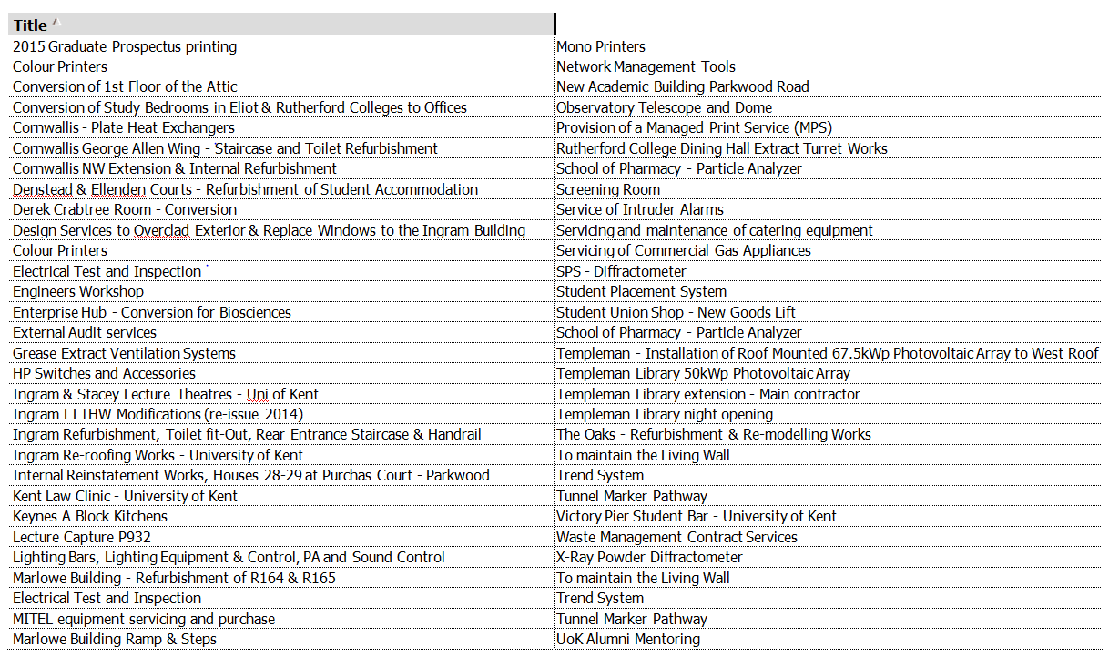
Recent competitions

Slide 17
Local procurement agenda
Why buy local
How we engage with Kent Business

Slide 18

Local procurement agenda
Part of Procurement Strategy - Local engagement agenda
Pragmatic procurement – best result locally
Questions within both PQQ and tenders to assist SME’s & local
Why buy local?
  Better service/delivery times
  More important to suppliers
  Improved supplier relationships
  Reduced environmental impact
  Price

Slide 19
Local examples
MFD’s
Balreed - Maidstone
Cleaning at Medway
Ridgecrest - Aylesford
Catering equipment servicing
Kent Catering Services – Sheerness
All through EU tenders

Slide 20
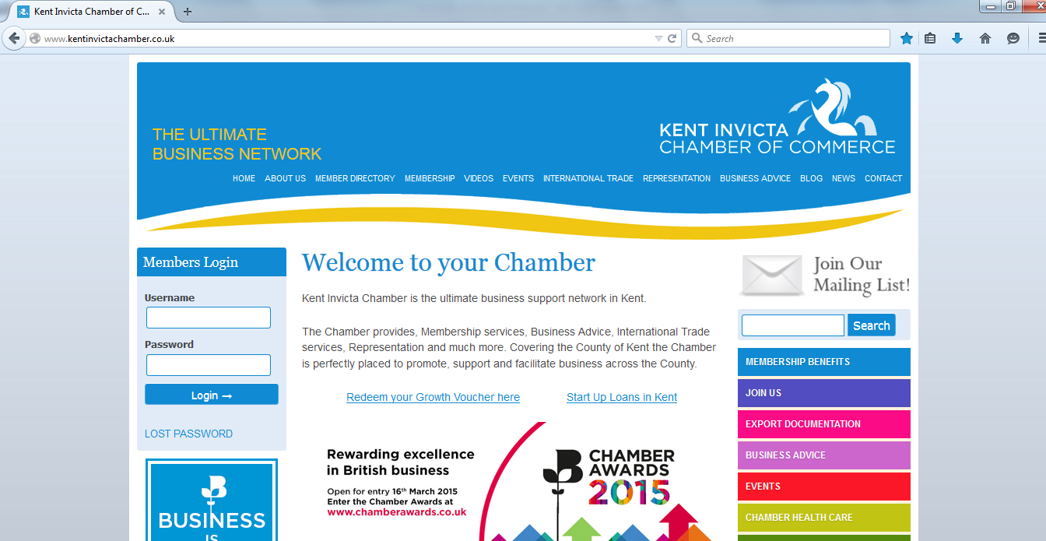
Supplier engagement

Slide 21

Finding public sector opportunities
Where to find opportunities
How to search for EU tenders

Slide 22
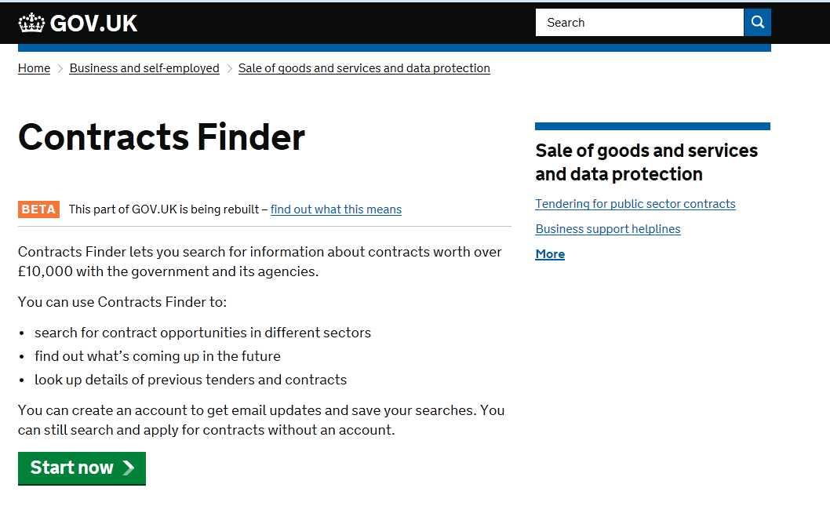
Contracts Finder

Slide 23
Bidding for public sector work
Should we bid?
Collaborative bidding

Slide 24
To bid or not to bid?
Is the tender a good fit in relation to your company’s activities?
Can you meet the eligibility criteria (technical qualifications, policy compliance e.g. Quality Assurance, Insurance) ?
Do you have a good track record in relation to the opportunity?
Do you have the trading history (e.g. 2 years Accounts)?
Do you have the capability and capacity to deliver the contract if successful?
Can you make sense of the budget and can you deliver the contract on time?

Slide 25
Strategic Decision Making
What are the risks?
Who are your competitors?
What percentage of your turnover does the contract represent?
Do you need a partner(s) or will you use subcontractors?
Does tender permit consortia/subcontractor response?
  Are there special requirements e.g. limitations on subcontracting, legal framework, etc?

Slide 26
Solo or Collaborative Bidding?
Options:
      Consortium
        Joint Bidding
        Lead Contractor & Subcontractor
Form a consortium if:
    You don’t have the capability or capacity
    You can’t meet the 20% rule
    A joint bid would enhance your chance of winning
Notes:
Consortium must be properly led, constructed, managed
Consortium jointly and severally liable

Slide 27
What is Collaboration?
Informal
Formal
Recognition of mutual interest
Trust (founded on relationships between key individuals)
Networking & Referrals
Mutual subcontracting
Legally defined Consortium (increasingly required by LAs)
Joint venture
Partnership / Merger

Slide 28

Collaborative Bidding: Benefits
Increase capacity and scope to bid without stretching resources
Overcoming PQQ impediments i.e. a shared trade history may overcome some problems (accounting history and 20% rule)
Combined strengths: capability (skills) , increased capacity and experience
Business Development:
Access new clients and markets

Slide 29
Collaborative Bidding: Benefits
Share development and delivery cost and dilute risk
Getting input into your tender
Mutual learning and innovative approaches
Improve chance of success

Slide 30
Collaborative Bidding: Challenges
Identifying a partner (Time + Effort)
Engaging a partner (Risks) – floating the idea (informal meeting) and formal meeting to negotiate and establish Agreement
Getting Agreement on roles, responsibilities
Getting Agreement on liabilities (jointly and severally liable)
Trust relationship (how well do you know your partner – can you be confident they can and will deliver)

Slide 31
Collaborative Bidding: Challenges
Complex decision-making, loss of autonomy, compromises and concessions
Sharing sensitive information & ‘know how’ (protecting your IP?)
Logistics: preparing proposal, contract negotiation and delivery
Buyer preferences (prefer 1 contractor) – risk averse

Slide 32
Choosing the right partner
Who would you be working with (individual expertise, experience, attitude and commitment)?
Could one opportunity form the basis for collaboration around other opportunities?
Would the PQQ present problems for them e.g. Director’s conduct, Trading History (Administration or Liquidation), Credit worthiness, Contract(s) terminated for default, Employment Tribunal (you may need to check)?

Slide 33
Choosing the right partner
Do you already have an existing relationship e.g. Trust & Shared Values (important in Third Sector)?
Can they and are they likely to deliver?
What is their reputation in the market?
Who do they already work for/with? (comparable client/service, etc)
Are they financially secure?
What Accreditations do they have?

Slide 34
Preparing a collaborative proposal
Agree Objectives
Client Requirement is mutually understood
Designing a solution
Roles and responsibilities in preparing the proposal (potential headache)
Milestones for preparation of proposal
Who will lead proposal (legal implications/framework)?
Project management, governance and communications

Slide 35
Preparing a collaborative proposal
How will contract be managed and operated?
Who will contribute what and when to deliver contract requirements?
Is it clear who gets what?
Balance of inputs? Are you the Senior or Junior Partner?
Contract negotiation, client liaison and decision making? Getting a seat at the table
Dispute resolution?
What if one partner defaults or the contract is terminated?

Slide 36
Improving your chances of winning
Examples
Final thoughts

Slide 37


Accentuate the Positive
Do you have a Health & Safety Policy?
Weak Answer:
  “Yes, see Appendix 1”
  Good Answer:
  “The Health & Safety of our staff and customers is a vital part of the company’s quality process. We operate a comprehensive Health & Safety Policy (see Appendix 1) covering all aspects of our products (services) and operations and it is reviewed biannually.”
  For an SME employing less than 5 people:
  “Although we are not required legally to have a Health & Safety Policy, we take this matter very seriously and have adopted a Health & Safety Policy in the interests of our staff and clients (see Appendix 1)”

Slide 38
Accentuate the Positive
What Quality Assurance arrangements does your company operate? If no accreditation is held please explain why not and what alternative steps you take to ensure quality at work?
Weak Answer:
  “We operate our own quality system. We have determined that formal accreditation is inappropriate to our company’s needs.”
Good Answer:
  “We regard quality as a vitally important part of our business activity and we operate a comprehensive and strict internal quality assurance process covering all aspects of our business activity (details can be found in Appendix 2). We are committed to a process of continuous improvement and we are in the process of applying for ISO 9001 (we expect to be assessed in May of this year)”

Slide 39
Some final thoughts
Be clear about when to bid and not to bid
Find out who your competitors are
Make early decisions about whether to go solo/consortium/subcontract
Understand what the buyer is looking for and bespoke bid accordingly
Remember you do not have to go it alone

Slide 40
Some final thoughts
In preparing bids recognise that nothing less than a professional approach will suffice
Always answer the question asked!
Think about why the question is asked and answer to meet this need
What are they looking for?
Stick to any word limits

Slide 41

Questions
d.bowman@kent.ac.uk

Slide 42
Selena Stray
Deputy Category Manager, Kent County Council

Slide 43

SME Procurement Exchange
Selena Stray
Deputy Category Manager for Construction & Maintenance

Slide 44
Strategic Sourcing and Procurement
Henry Swan
Head of Procurement
Terry Hazlewood
Category Manager: Corporate, Learning & ICT
Susan Dartnall
Deputy Category Manager:
Transport & Waste
Selena Stray
Deputy Category Manager:
Construction & Maintenance
Clare Maynard
Category Manager:
Care
procurement@kent.gov.uk
Notes:
Terry:
The Corporate & Learning Category provide Procurement services to a wide range of areas in support of our corporate functions, e.g. Communications, HR/Training Frameworks, Professional services.
The ICT category covers for procurements relating to computer hardware, software, network and cloud​, e.g. Microsoft, Oracle, KPSN.

Slide 45
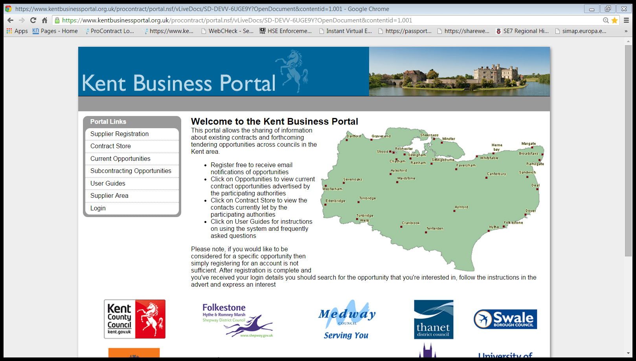
www.kentbusinessportal.org.uk
The portal allows the sharing of information about existing contracts and forthcoming tendering opportunities across councils in the Kent area
You can register for free to receive email notifications of opportunities
You can view current contract opportunities advertised by the participating authorities
You can view the contacts currently let by the participating authorities

Slide 46
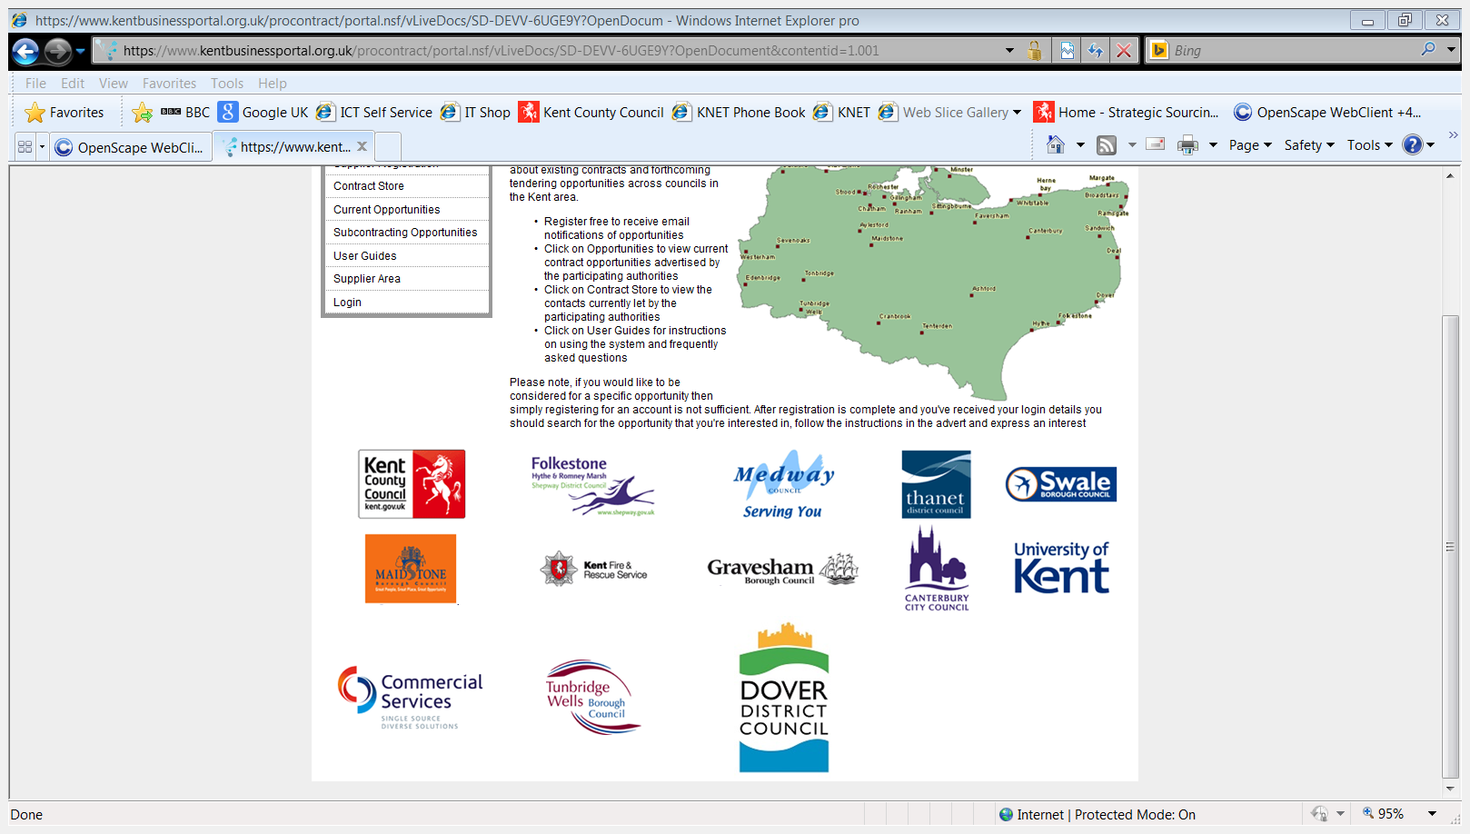
Participating Authorities

Slide 47
How The Kent County Council Advertise Opportunities
Tenders with an estimated contract value of over £50 thousand are advertised on the Kent Business Portal under the section “Current Opportunities”
Tenders with an estimated contract value of over £50 thousand are advertised on the Contracts Finder
Tenders with an estimated contract value of over the EU Thresholds are advertised on the Kent Business Portal, Contracts Finder and in the European Journal

Slide 48
How The Kent County Council Publicise Contracts
Contracts with a value of over £50 thousand are publicised on;
  Kent Business Portal “Contract Store”
  Contracts Finder
Notes:
Start/End dates
What the procurement route was
Who can access the contract (other authorities)
The Authorities Contact Details
Supplier Details

Slide 49
Kent County Council Property Department Contracts
Total Facilities Management (3 Contracts)
Property Services Consultancy Framework
Principal Contractors Framework
Asbestos Services Framework

Slide 50
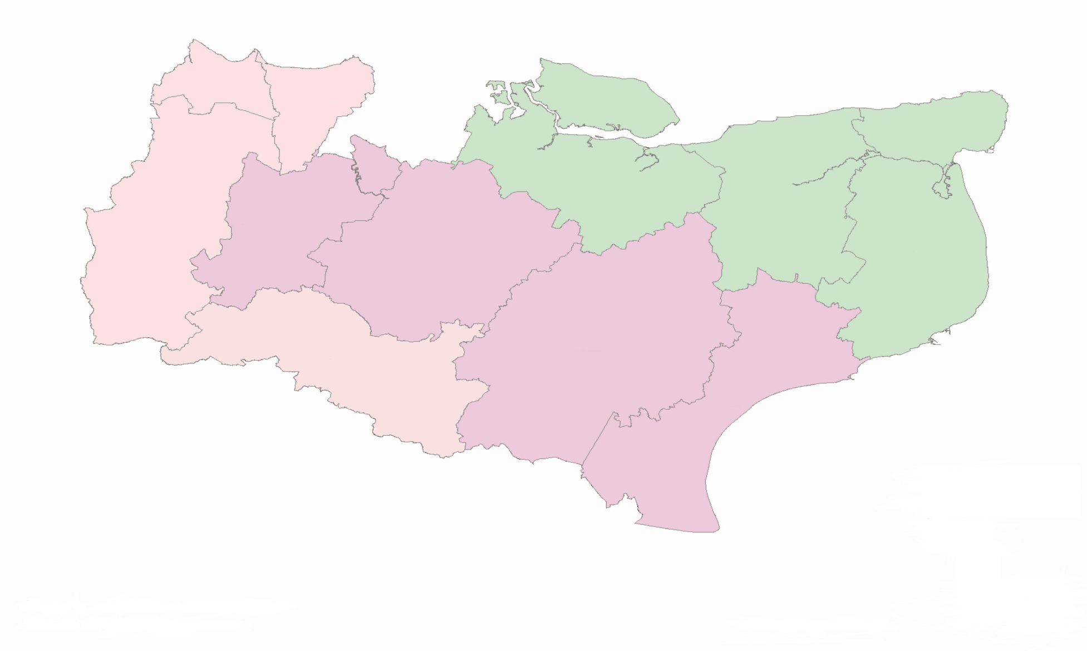
Total Facilities Management
Dartford
Gravesham
Thanet
Swale
Sevenoaks
Tonbridge &
Malling
Canterbury
Maidstone
Dover
Ashford
Tunbridge Wells
Shepway
West Kent
Skanska Facilities Services
Mid Kent
Amey Community Limited
East Kent
Kier Services ltd
Notes:
5 year Contract with option to extend for a further 2 years
Facilities Management services such as building maintenance, cleaning, catering, community lettings, ground maintenance, security …
Initially this is for Corporate Buildings – Offices, libraries ..
In dialogue to incorporate Schools

Slide 51
Total Facilities Management Contact Details
West Kent
Skanska Construction UK Ltd trading as Skanska Facilities Services
Lloyd.smith@skanska.co.uk
Mid Kent
Amey Community Limited
Mark.billington@amey.co.uk
East Kent
Kier Services Ltd
Ben.bull@kier.co.uk

Slide 52
Property Services Consultancy Framework
Lot 1 Architecture
Lot 2 Lead Consultant / Employers Agent / Project Management
Lot 3 CDMC co-ordinator
Lot 4 Mechanical and Electrical Engineering
Lot 5 Structural and Civil Engineering
Lot 6 Quantity Surveying
Lot 7 Clerk of Works
Lot 8 Environmental Services
Lot 9 Building Surveying
Lot 10 Multi - Disciplinary
Notes:
4 year framework 29/05/2014 to 30/06/2018

Slide 53
Principal Contractors Framework
For Lot 1
  Works for a value up to £750,000, “construct only” services (no design requirement)
For Lot 2
  Works between a value of £750,001 - £6,500,000, “develop & construct” services or “construct only”
Notes:
Each lot will have up to 11 contractors on each
Contractors will be advertising sub-contracting opportunities on the Sub-Contracting Portal

Slide 54
Asbestos Services Framework
Lot 1
  Management Surveys
  Refurbishment Surveys
  Demolitions Surveys
  Bulk Sampling
  Statutory Compliance Training
  Emergency Call-out Service
  Minor Remediation Works
Lot 2
  Asbestos Removal Works
  Asbestos Encapsulation Works
  Emergency Call-out Service
Lot 3
  Air Testing – Carrying out of personal, background, reassurance and reoccupation sampling as per HSG 248
  Leak Tests
  Background Air Testing
  Reassurance Air Testing
  Personal Monitoring
  Four Stage Clearance (including reoccupation certification)
  Emergency Call-out Service
Notes:
Due to go out to ITT using OJEU Open Procedure late May
Advertised on Portal and EU Journal

Slide 55
The Use of the Kent Business Portal for Contractors to Advertise their Sub-Contracting Opportunities
Free to use by any contractor to advertise sub-contracting opportunities in Kent.
Contractors can advertise opportunities on any project, not just limited to Public Sector projects.
Notes:
Danny will be demonstrating this this afternoon

Slide 56

Meet The Buyer
Wednesday 7 October 2015,
Kent Event Centre, Maidstone (Detling Show Ground)
8.30 am - 4.30 pm
www.kentconstructionexpo.co.uk
Notes:
3 TFM Contractors
Principal Contractors from the FW
Plus House Builders tbc

Slide 57
James Harris
Category Manager People, Medway Council

Slide 58



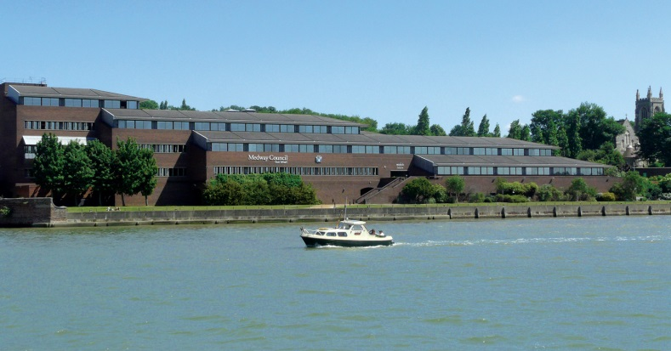
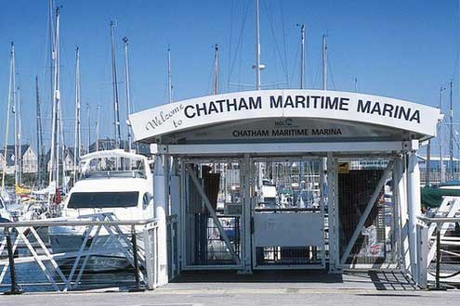
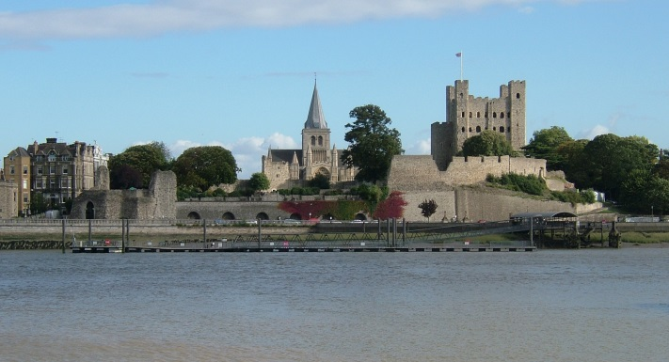
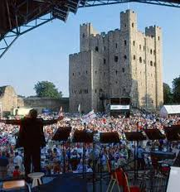
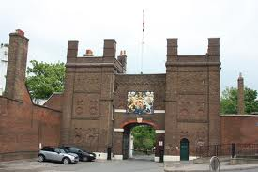
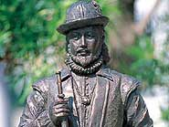
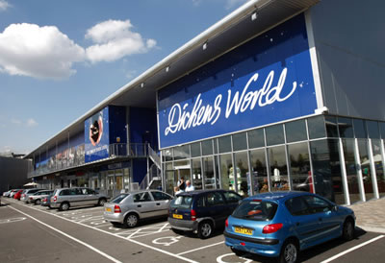
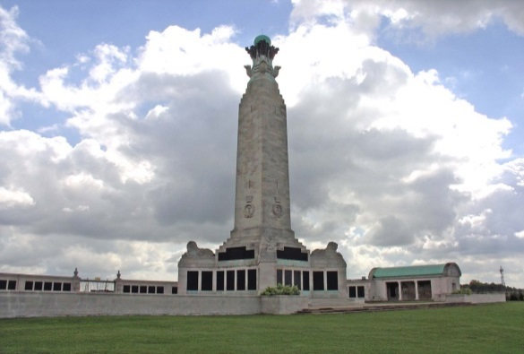

Medway Council Category Management
28th April 2015

Slide 59

Content
Procurement Strategy
SME Engagement
Projects we have done
Procurement Legislation
Medway Opportunities 2015/16

Slide 60
Category Management: Who Are We?
Head of Category Management Place
Carl Rogers
Category Manager
James Welch
Public Health
Category Manager
Richard Barrett
Public Health, ICT
Category Manager
Jack Moss
ICT, Energy, HR, Finance
Assistant Category Manager
Marsha Wrye
Assistant Category manager
Lauren Gibson
Head of Category Management People
James Harris
Category Manager
Janet Elliott
Housing, Works, Hard FM
Assistant Category Manager
Morris Williams
Concessions, Soft FM
Category Manager
Mike Kelly
Fleet, Environment, Works
Category Manager
Nigel Ford
Highways, Works
Assistant Category Manager
Linda Jones
Concessions, Works
Category (Graduate)
Sandra Asiedu
Social Care

Slide 61

Procurement Strategy
Four themes
Improved services, better outcomes
Reduce red tape
Support the local economy
Intelligent spending

Slide 62
Category Management
What is Medway Council Doing for SMEs?
Advertising all opportunities via the Kent Business Portal & Contracts Finder
Using PAS91 as standard PQQ for above Threshold Procurement
Holding Meet the Buyer Events and attending Supplier Engagement Days
Signposting to other support organisations Eg BSK CiC, TrAC Ministry for Growth, Chamber of Commerce
Engaging with Industry bodies such as Federation of Small Businesses, National Federation of Builders
Ethical Procurement

Slide 63
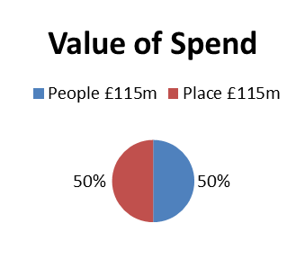
Third Party Spend
People
Place
People covers the following:
Social & Community Care
Healthcare
Housing Support
Education
Community Advisory services
Arts & Leisure services
Consultancy
Human Resources
ICT
Legal Services
Stationery
Place covers the following:
Cemetery & Crematorium
Construction/works
Environmental services
Highway equipment & materials
Horticultural
Housing management
Passenger transport
Street & Traffic management
Complex & significant projects
Equipment & maintenance
Facilities management services
Vehicle management
Furniture & soft furnishings
Health & safety
Utilities

Slide 64
Category Management
What Do Others Say About Us?
“Of all the councils in the county, Medway Council procurement team are probably doing the most to engage businesses.”
Tudor Price, Kent Chambers of Commerce
“What an amazing "Meet the Buyer" event with Medway Council who genuinely want to do business with local SME's. It is so refreshing to hear that the Council is committing to spending with good contractors in Medway and Kent. It's up to the SME community to prove they are a remarkable contractor for Medway Council projects but I genuinely believe there are some great working partnerships that will come out of today's event. I'm looking forward to tendering for projects on the Kent Business Portal. I wish there were more Buyers with this approach to getting procurement right.”
Julie Anderson, Director Rap Interiors

Slide 65
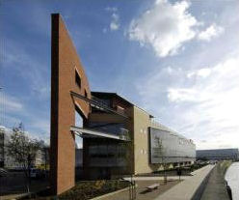
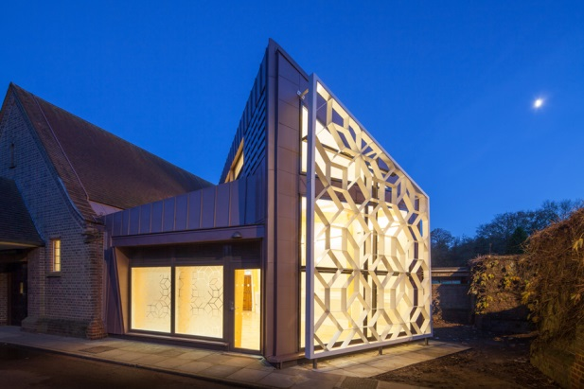
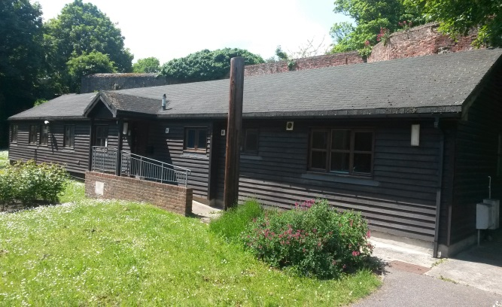
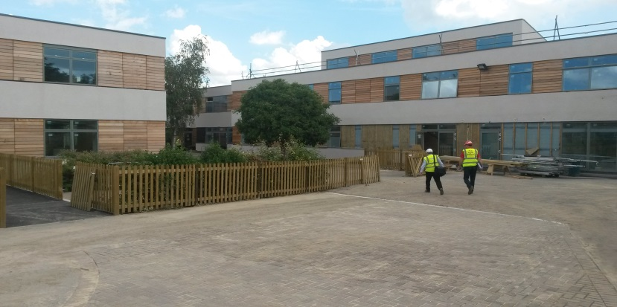
Some of Our Projects
New Horizons (£5m school) Chatham
Broadside (3 team co-location) Chatham
Housing – Boilers, Fire Doors & Roofing (£4m)
Chatham Waterfront Digital Screen
SEN Transport (£50m)
Construction Professional Services Consultancy
Building new Council houses in Gillingham (£4m)

Slide 66



Some of Our Projects
Old Vic Childrens Home
Supported Living
Community Equipment
Dermatology Level 3 & 4 services
Opthalmology
Community Care Beds
Mobile Phones
Salary Sacrifice Cars
ICT

Slide 67
What is Medway Council Governed by?
3 Strands
1. EU Procurement Directives (European Law)
2. Public Contracts Regulations 2015 (UK Law)
3. Contract Procedure Rules (Medway Council)

Slide 68
What is Medway Council Governed by?
EU Procurement Directives (European Law)
EU Thresholds:
  Goods/Services: £172,514
  Works: £4,322,012
EU Procedures:
  Open (35 Days, Electronic 30 Days, PIN 15 Days)
  Restricted (PQQ 30 Days, ITT 30 Days, Electronic 25 Days, PIN 10 Days)
  Competitive Dialogue (30 Days)
  Competitive Procedure with Negotiation (As Restricted)
  Innovation Partnerships (30 Days)

Slide 69
What is Medway Council Governed by?
2. Public Contracts Regulations 2015 (UK Law). Follows the principles of EU law such as:
Equal Treatment
Transparency
Non Discrimination
Changes: No PQQ Stage, Advertise on Contracts Finder, Concession Contracts No Exemption, No Part A Part B, Introduction of Light Touch Regime, PINs as call for Competition, Abnormally Low Tenders, Changes in Minimum Time Limits.

Slide 70
What is Medway Council Governed by?
3. Medway Council Contract Procedure Rules
Thresholds
£0 - £10k – 1 Quote
£10k - £100k – 3 Quotes
£100k + Open Market Tender

Slide 71

Medway Opportunities2015/16
Rochester Riverside Development (estimated value £300m)
Minor Works/Low value Construction Framework (estimated value £50m)
Transport Local Growth Project (estimated value £24m)
Highways Maintenance Framework (estimated value £8m PA)
Chatham Town Centre Regeneration (estimated value £4m)
Public Health (estimated value £10m)
ICT (estimated value £2.5m)
Printing (estimated value £1m)
Traffic Management Software (estimated value £50k)
2FE expansion in Gillingham
2FE expansion or new school in Strood
Napier Primary School
Highways Maintenance Framework
Minor Works/Low Value Construction Framework
Advertising
Waste Collection and Disposal
Highways Term Maintenance & Street lighting
Transport Local Growth Projects
Chatham Town Centre Regeneration
Rochester Riverside Development
Kent & Medway Air Quality Monitoring
Chatham Bus Station Travel Information Centre
Digital Screen Maintenance
Abbey Court
School Condition Programme
Hundred of Hoo Academy
Saxon Way Primary School
Rochester Airport
Strood Riverside

Slide 72
So Where are the Opportunities?
The Kent Business Portal
https://www.kentbusinessportal.org.uk/procontract/
https://www.contractsfinder.service.gov.uk/Search

Slide 73
Any Questions?

Slide 74
Alan Marolia
Procurement Support Manager, Swale Council

Slide 75

Swale Borough Council Procurement
Alan Marolia
Contracts and Procurement Support Manager

Slide 76
What are SME’s?
European Commission has defined ‘small’ as being less than 50 employees; ‘medium’ as between 50 and 250 (Commission Recommendation 2003/361/EC(39))
Such business are hugely significant to the United Kingdom economy –in 2013 99.9% of UK businesses were SMEs, accounting for 60% of private sector employment
UK Government spends over £230BN p.a. on procuring goods and services
Target has been set that 25% of goods and services will be procured from SMEs by end of 2015

Slide 77
What we Do
We are a Small Team of two.
Annual Expenditure is around £14m.
We have 126 Formal Contracts in Place worth £76.9m
Total Annual Contract Value makes up 63% of the Council’s total annual expenditure.
C+P are involved with all procurements >£15k.
We offer procurement advice, our opinion and expertise based on previous experience, legislation and case law.
Ensure that Procurements follow national and European legislation.

Slide 78
Why we do it
Ensure that there are appropriate contractual arrangements in place and tackle areas where there appears to be nothing in place.
Public Money – WE ARE ACCOUNTABLE and are financially audited annually
To allow equal treatment, non discrimination, transparency, advertising, proportionality and a level playing field
Prevent C.A.s using the same or their favourite contractors
Protection for C.A.s and E.O.s

Slide 79
How we do it
Commissioning Team
Establish collaborative working opportunities.
Determine Length of Contract.
Break into lots where practicable
Estimated Contract value to determine threshold.
Compile Tender documentation and Apply relevant T&Cs based on value and risk.

Slide 80
How we Do it Continued………….
CSOs, E.U. Regs. / PCR2015
Thresholds
Advertise
Evaluate
Council Process
Award
Financial checks on occasion

Slide 81
What we can help SMEs
Creating lots
Simplifying Documents and T&C
E-Procurement
Suppliers list
Review our thresholds
Social Value Act 2012 – Local First Policy
Can we Favour SMEs?
Open Procedure

Slide 82
What can you do
Register on Kent Business Portal
Visit our Website – www.swale.gov.uk
Provide Feedback on tender documents
Contact lead officers with questions.

Slide 83
Questions ?

Slide 84
Don Bowman
Head of Procurement, University of Kent

Slide 85
Tea, Coffee and Networking
Meet the Buyer Appointment Registration (Lille Room)

Slide 86
Fit to Supply Workshop and Panel Discussion

Slide 87


Fit to supply...
Giving you a competitive edge to win contracts
Presented by
Susan Rom & Graham Clarke
Partners at BIZphit LLP
‘Helping to get you tender fit’
© BIZphit™ 2015

Slide 88


About BIZphit LLP…
We are a business development consultancy specialising in helping small businesses to supply their goods and services into the Public Sector. We support SME’s with:
Procurement
Supply Chain Activity
Business Development
Business Coaching & Mentoring
G
S
© BIZphit™ 2015

Slide 89

Are you ready to supply – Things to consider…
Risk Management
Health and Safety
Quality Assurance
Environmental Management
Diversity and Equality
Professional Capacity
Technical Capacity
eProcurement
Financial Standing
© BIZphit™ 2015

Slide 90
Our experience – Common Mistakes Made by Suppliers
Leaving things too late – crisis management!
Insufficient preparation
Incomplete polices, processes and procedures
Lack of focus
Lack of resources
Failed to read the specification thoroughly
Answering questions out of context
Lack of understanding of the buyers criteria
© BIZphit™ 2015

Slide 91
Our Top 10 Tips..
Is it right for your business?
Focus and Commitment
Preparation
Understand your products and services
Realise your boundaries
Accuracy of submission
Time management
Current policies and procedures
Professional and technical capacity
Alignment with the buyer
© BIZphit™ 2015

Slide 92
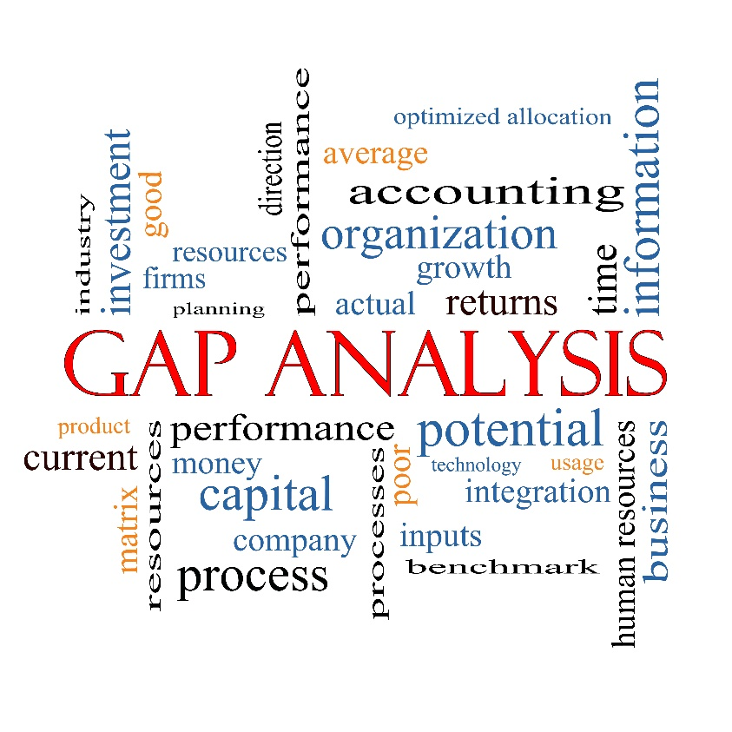
Supplier Gap Analysis – How it Works.
The Gap Analysis is a business audit we have developed to assist clients to become ‘fit to supply’ and to help them WIN contracts.
© BIZphit™ 2015

Slide 93
Panel discussion led by Gary Downey of Balreed
Panel Members
Gary Downey
Don Bowman
Selena Stray
James Harris
Carl Rogers
Alan Marolia
© BIZphit™ 2015

Slide 94
Thank you
Fit to supply...
Giving you a competitive edge to win contracts.
Presented by Susan Rom & Graham Clarke
Partners at BIZphit LLP
‘Helping to get you tender fit’
Thank you
procurement@bizphit.co.uk
01245 835 085
© BIZphit™ 2015

Slide 95
Lunch and Networking
Meet the Buyer Appointments (Lille Room)
Procurement Helpdesk (Conference Hall)
Guided Portal Registration Support (Conference Hall)

Slide 96
Thank you for attending Please remember to hand in your feedback forms

